Slide 1
Geo-Information Systems in University of Georgia
Sergo Tsiramua
Professor of University of Georgia
Founder of “Tourism Geo-Information Center”
George Tsiramua
Toyota IT Projects manager
Founder of Biliki
Tbilisi - 2019

Slide 2
Main purpose of GIS in UG education system
Teach students to use modern GIS solutions of managing, planning and analyzes
Network and Communications
Logistics
Tourism
Archeology
Rural Development
Ecology
…

Slide 3
GIS in schools of The University of Georgia
Since 2005
Bachelors, Masters, PHD, Short Courses
School of Science and Technology
Information Technologies and Engineering
School of Art and Humanities
Archeology
School of Health Science
Statistical Analysis
School of Business and Administration Studies
Tourism

Slide 4
Main GIS directions in The University of Georgia
Geo-Informatics – Main Course based on MapInfo Professional
Geo-Information System ArcGIS – selective course
GIS Technologies in Tourism – Main Course based on MapInfo Professional and TravelGIS

Slide 5
Projects created by Students
Okan Eray’s Master Thesis - Education Analysis and Planning for Georgian Schools (2010)
Demographics and Rural Development
Show statistic values on map
Rating to public schools, to private schools
Success of schools among to others
Around the school design map of crime density
Around the school design map of traffic density

Slide 6
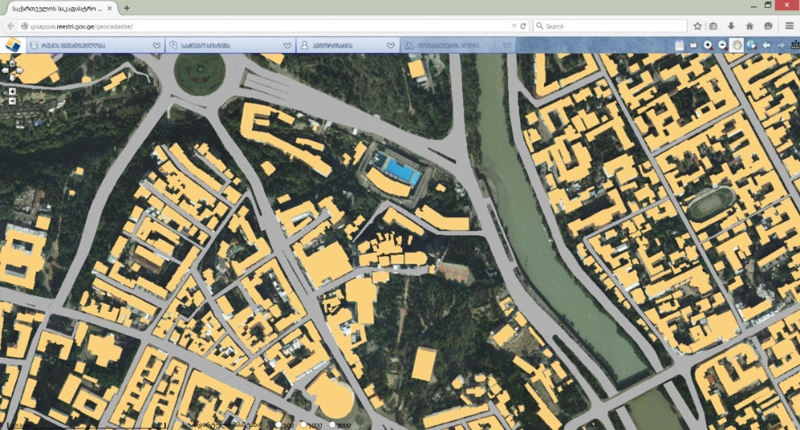
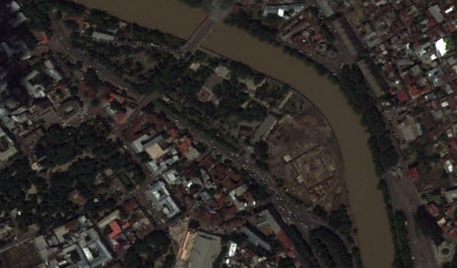
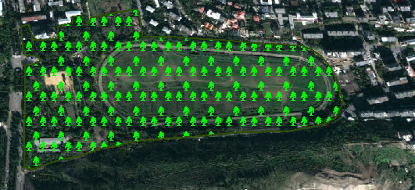
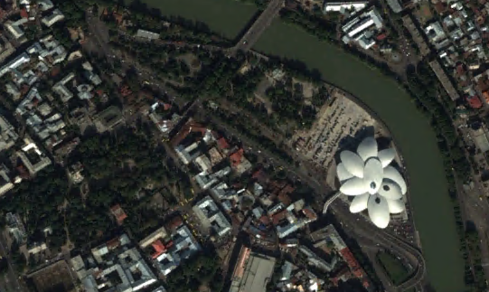
Projects created by Students
Davit Gigilashvili and Temur Makbaniani Bachelor Thesis – Dynamics of changes of green environment of Tbilisi (2015)
Ecology
Environmental studies
Rural Development

Slide 7
UG GIS Center
Founded in 2016
Main purpose
Development of GIS study programs
Increase awareness about importance of GIS in different fields of study and business
Participation in different university and science projects in the field of GIS
Involvement of students in different international projects
Management and support of student projects

Slide 8
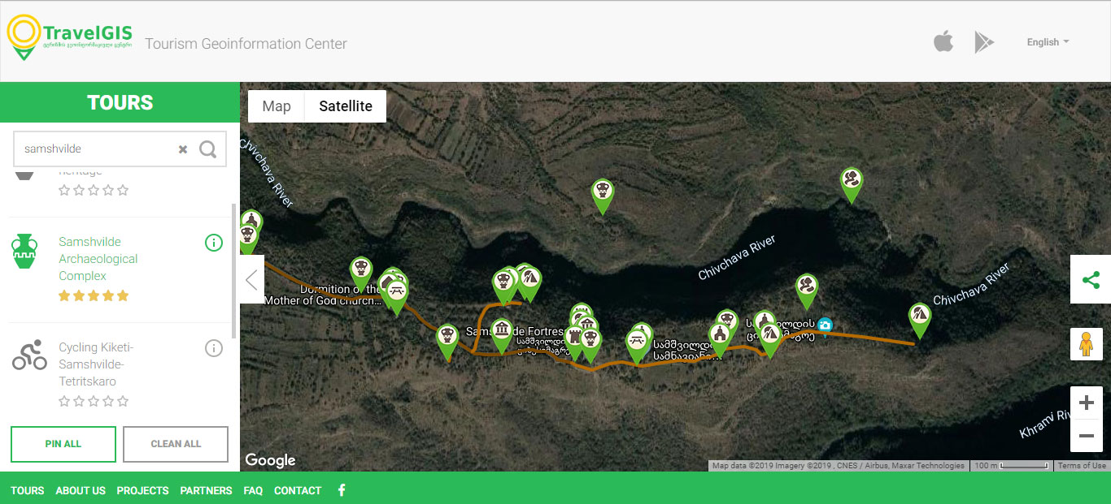
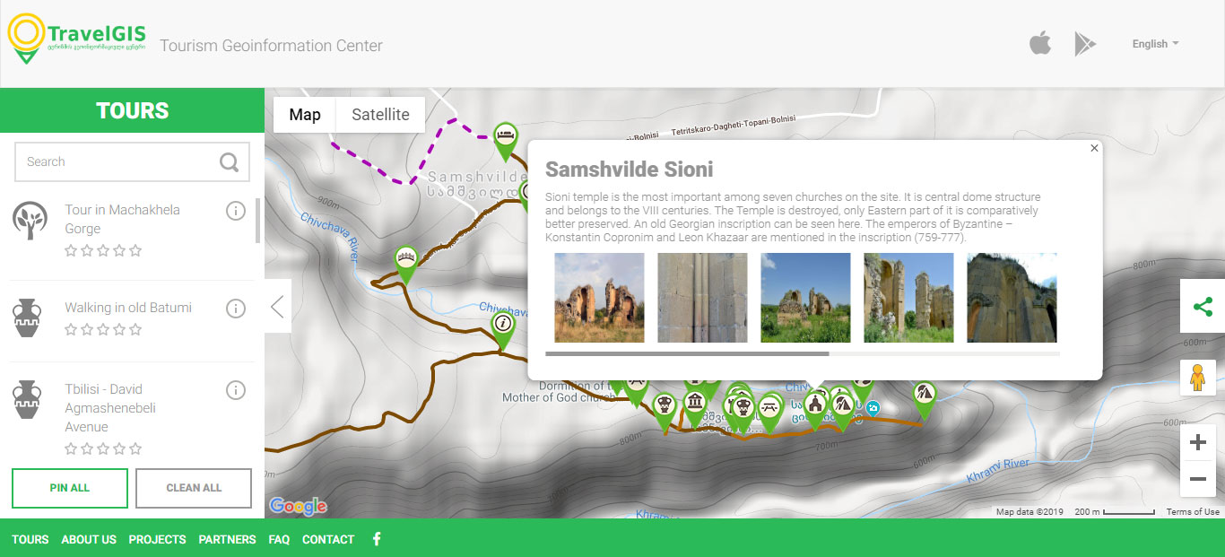
Projects created by Students
Touristic guide of Archeological Complex Samshvilde based on tourism platform TraveGIS
Field activities
Archeology
Tour planning
Tourism development

Slide 9
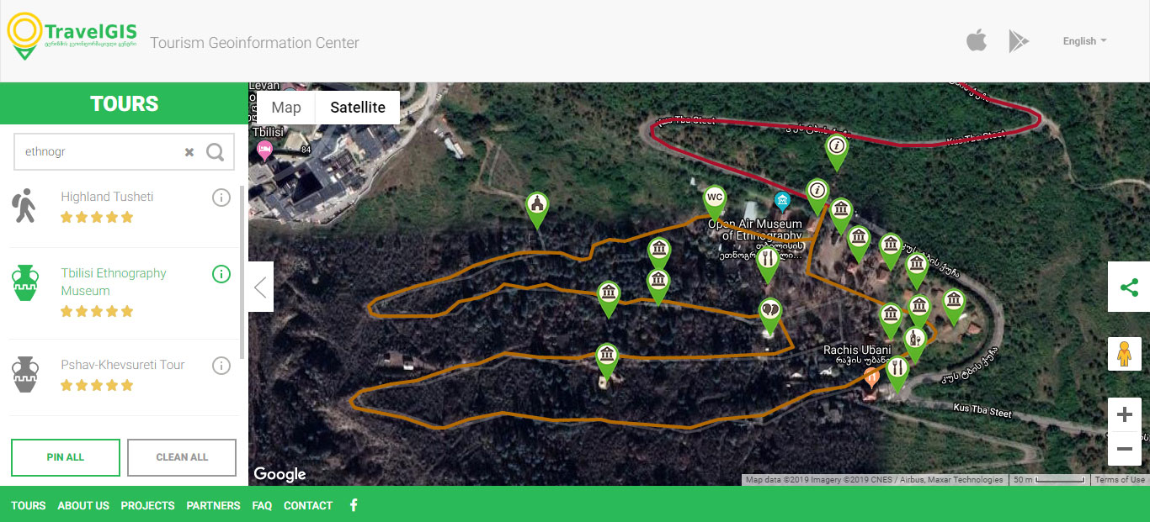
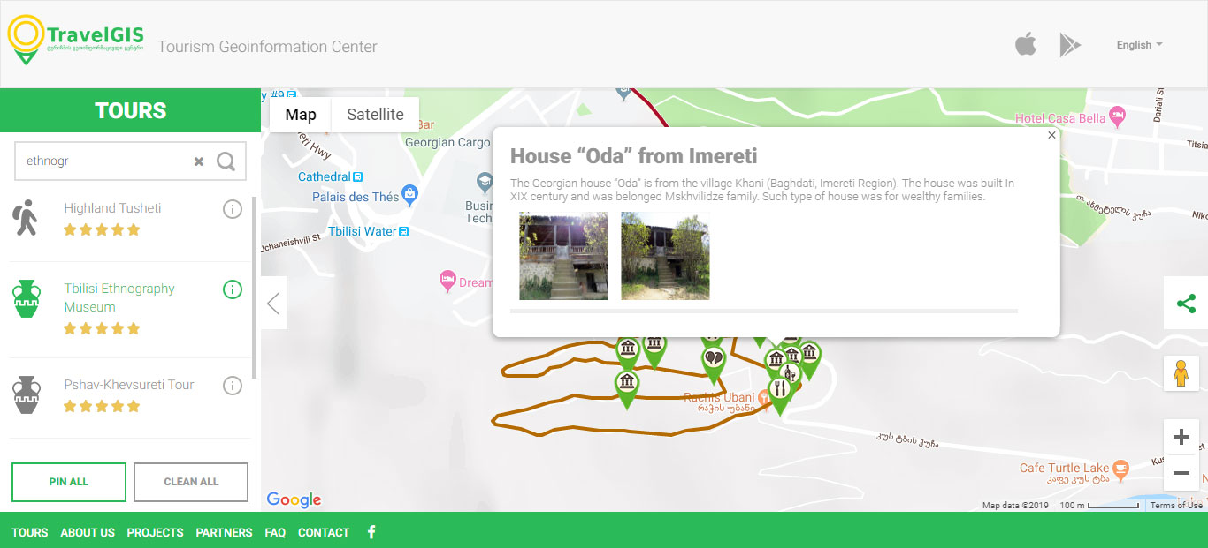
Projects created by Students
Touristic guide of Tbilisi Ethnography Museum based on tourism platform TraveGIS (Bachelors Thesis)
Ethnography and History
Tour planning
Tourism development

Slide 10
GIS Short Courses
Developed in 2008 and mainly used by organizations
Georgian telecommunications companies
Railway Department of Georgia
…
Success Story:
GIS Group was created in Silknet, under department of network development. GIS Group implemented a system for network planning and monitoring. Also web platform for management in order to monitor the entire network of Tbilisi and Georgia

Slide 11
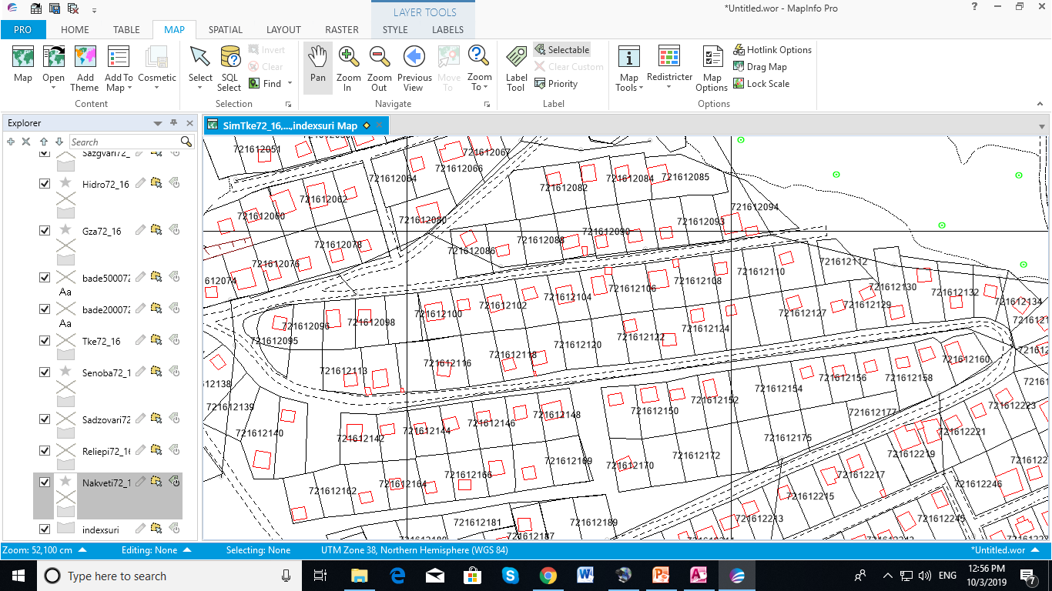
GIS Past Experience
Created Land Registration System of Georgia in World Bank (WB) & IFAD Project “Georgian Agricultural Development”
Managing IT&GIS Group and Consultant in – Land Registration Unit – 1998 - 2004

Slide 12
Tourism Geo-information Center
UG partner Nonprofit Organization – “TravelGIS” was created in 2011
Main Purpose
Create national Geo-information system (GIS) of Tourism
Insert geo-database of touristic objects on the touristic GIS map
Research of Georgian cultural heritage, natural sites and other touristic resources
Generate new touristic routs and digitalize current routes
Create tourism security nonstop monitoring system
Publish tourism information materials in Georgian and Foreign languages
Organize training, seminars, exhibitions, contests and conference

Slide 13
Main Projects of Travel GIS
Tourism Web Platform www.travelgis.ge - 2011
Research Archeological Tourism Potential of Kvemo Kartli - 2012
Research of Wine Tourism Potential in Georgia - 2012
Bachelor Course “Geo-information Technologies in Tourism” - 2013
Mobile App “TravelGIS” – 2014
Visitors Management Plan in Imereti – 2015
Researching regional level tourist facilities - 2014-2017
Discover Georgia in Your Village – 2016-2017
Increasing tourism potential in bordering regions of Azerbaijan and Georgia – 2018-2019
Tourism mobile App “Biliki” - 2019

Slide 14
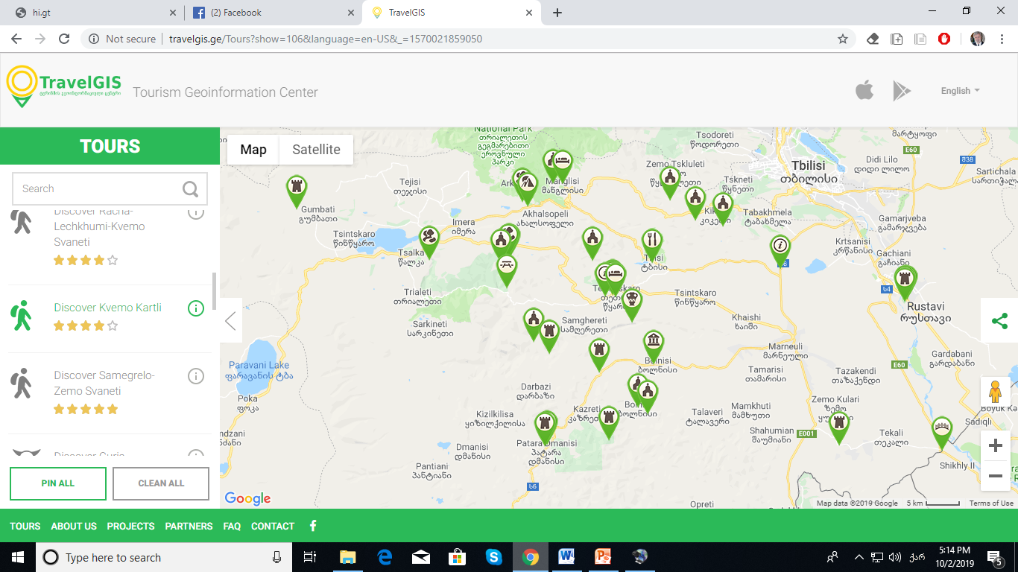
Research of touristic potential of Georgia and create geo-database of touristic resources in TravelGIS. The project was financed by The University of Georgia and National Tourism Administration.
Discover Georgia In Your Village

Slide 15
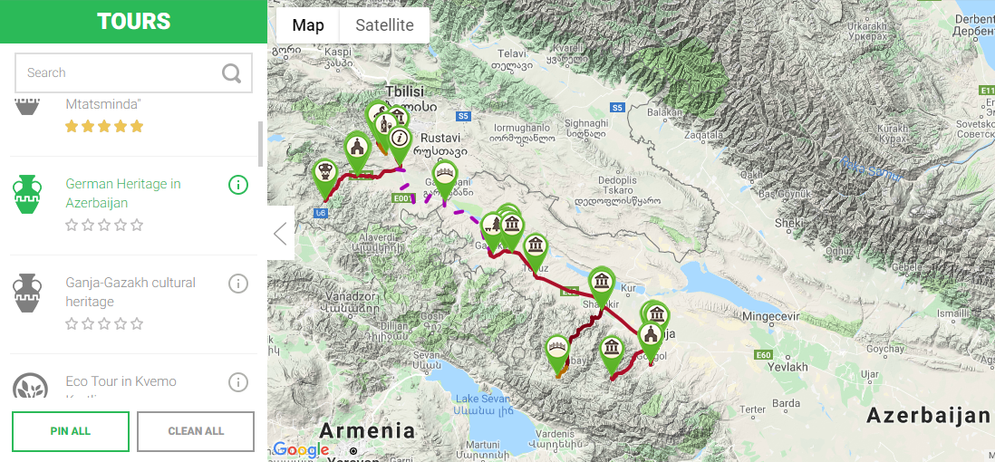
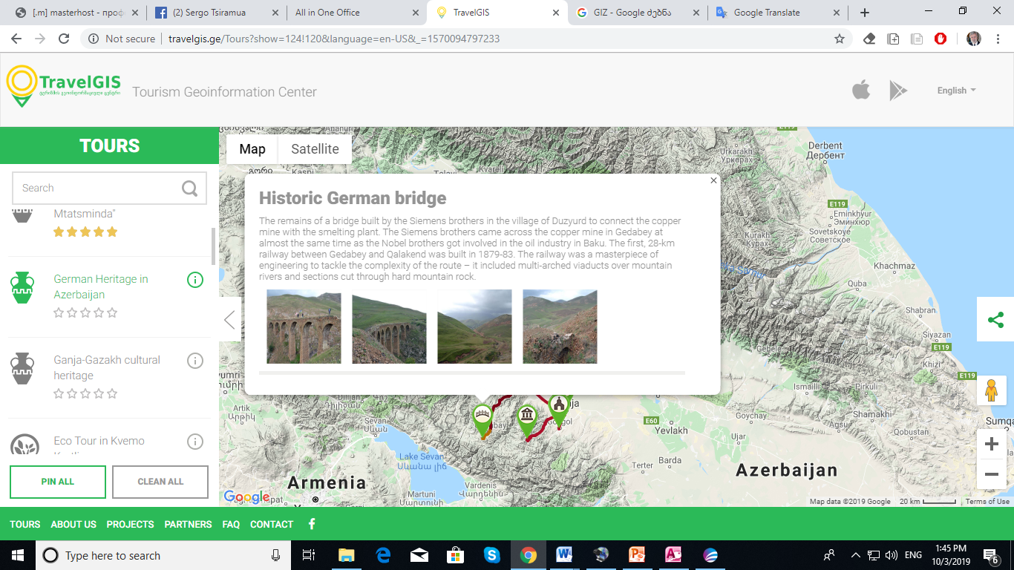
Kvemo Kartli (Georgia) - Ganja-Gazakh (Azerbaijan) German Heritage
The international project is co-financed by the European Union and managed by the German Society for International Cooperation (GIZ) within the Eastern Partnership Territorial Cooperation program.

Slide 16
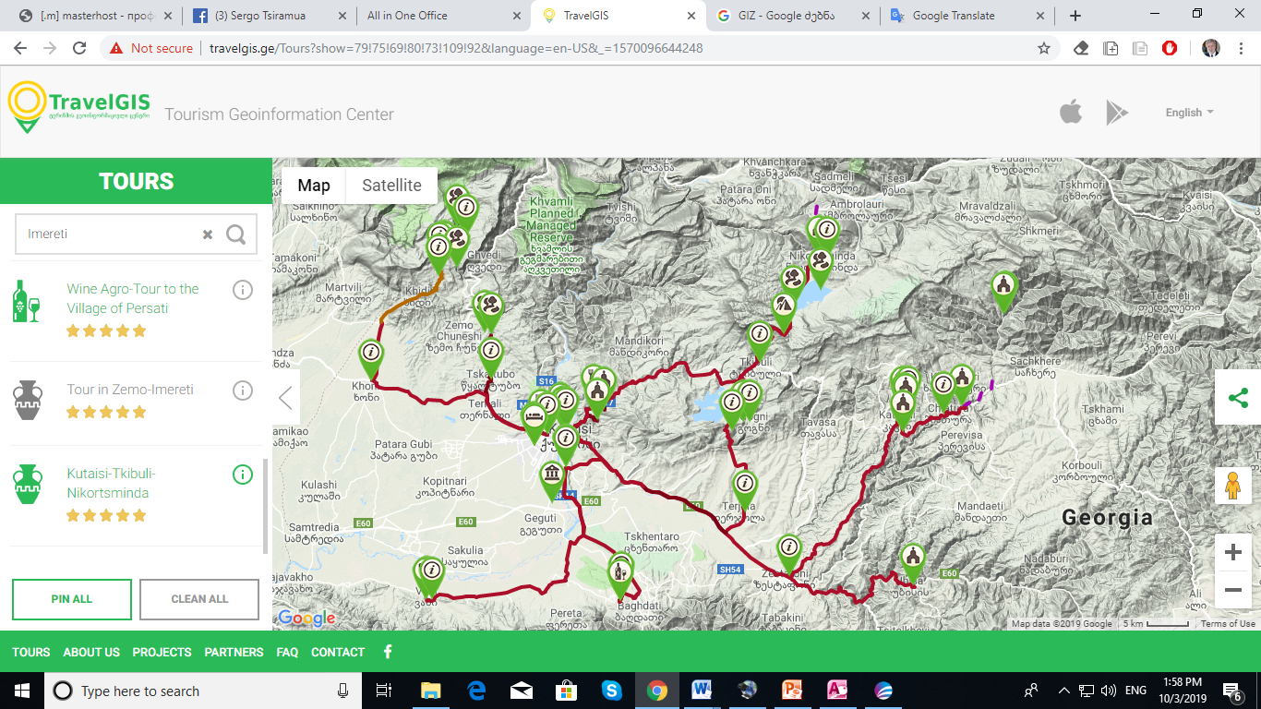
Visitors Management Plan in Imereti Region
The international project “Visitors Management Plan” (VMP) for selected Cultural Heritage Sites was managed with Italian company SiTI - Instituto Superiore sui Sistemi Territoriali per I’Innovazione.
The project was financed by Municipal Development Fund of Georgia – MDF.
Professors from UG were invited as experts.

Slide 17
Tempus and Erasmus Projects
Development of Tourism Bachelors and Masters Programs (2015)
Best practice sharing in Girona State University
Created a course GIS Technologies in Tourism for Bachelors and Masters programs.
Presentation: WEBGIS and Mobile Platforms of Touristic Resources at the conference in Ruse, Bulgaria, under Erasmus+ project (2019)

Slide 18
Cooperation Scheme
Governmental Organizations
Universities
Private Organizations, NGOs
Donor Organizations

Slide 19
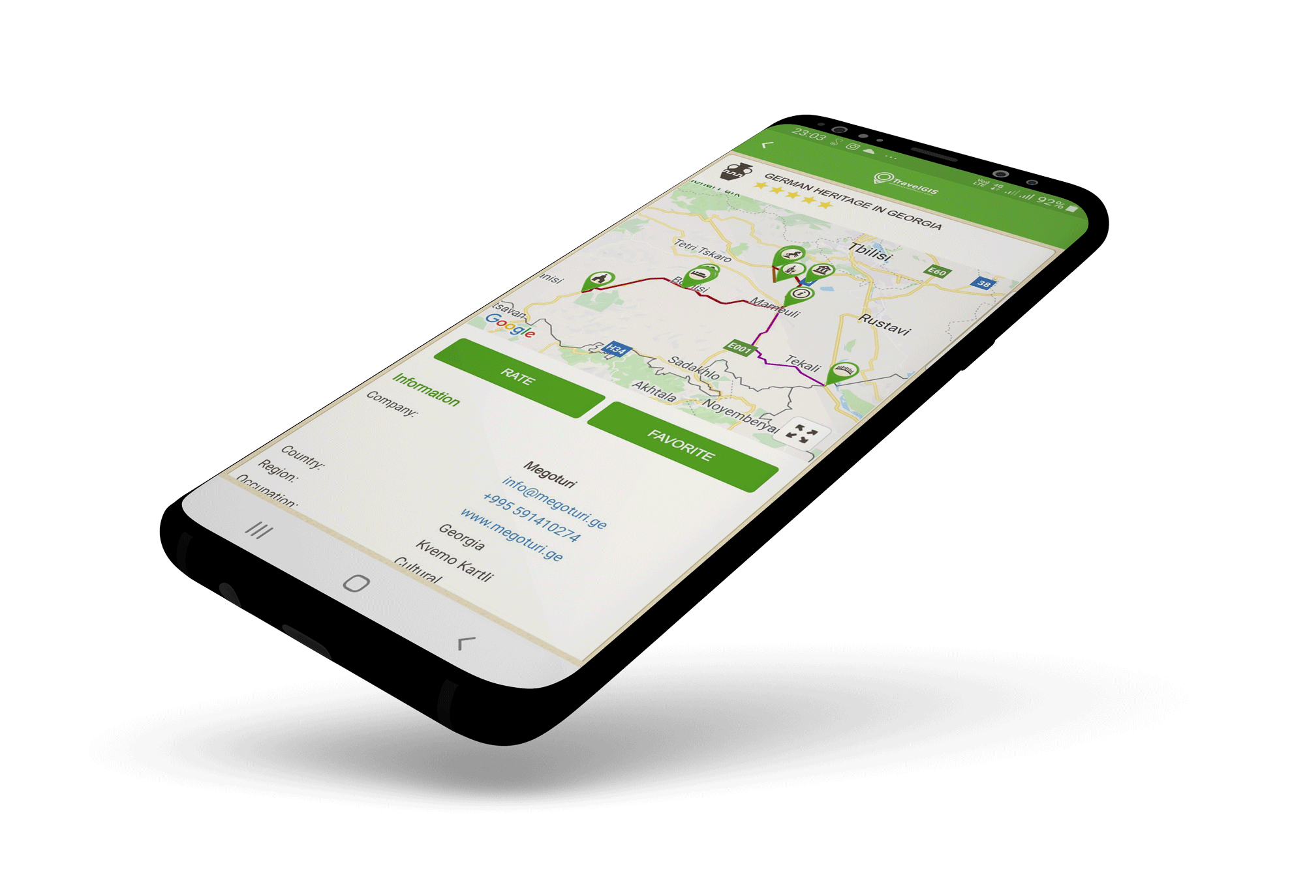
Mobile App TravelGIS
Free mobile app “TravelGIS” for Android
Innovative idea and technology;
Objectives – show the touristic resources and routs of the country to the world;
Three languages – Georgian, English, Russian;
Rich verity of tours;
User friendly interactive map;
Rich verity of touristic destinations
Ability to see own location;
Open for every one in the world.

Slide 20
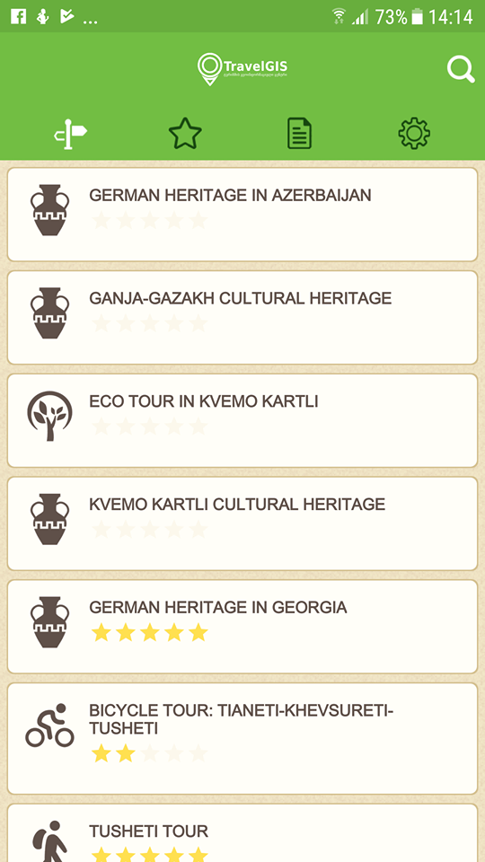
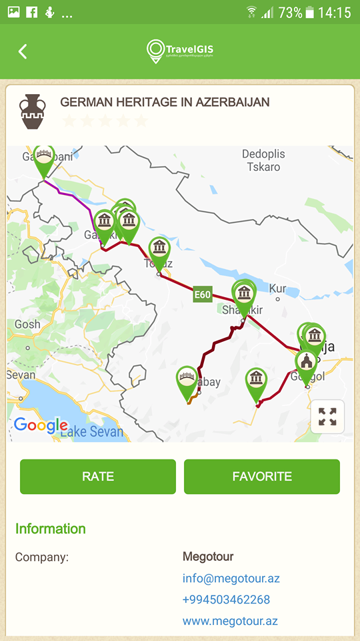
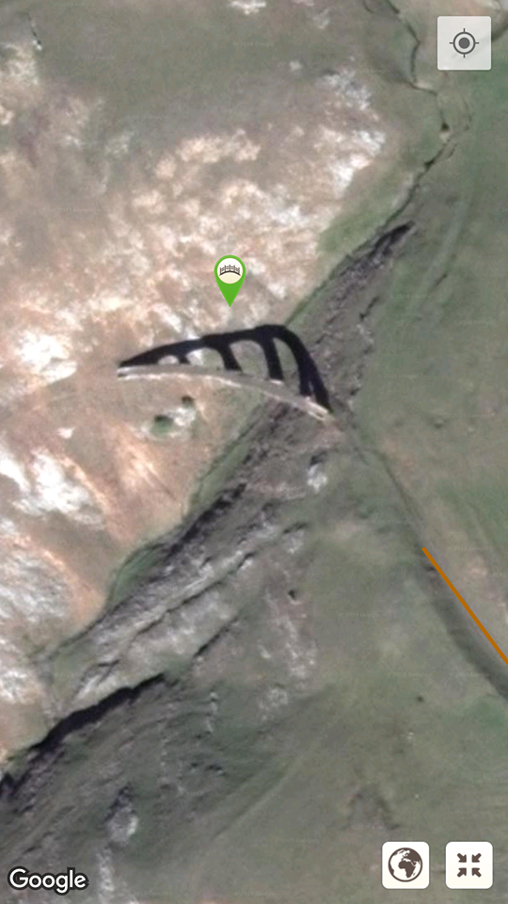
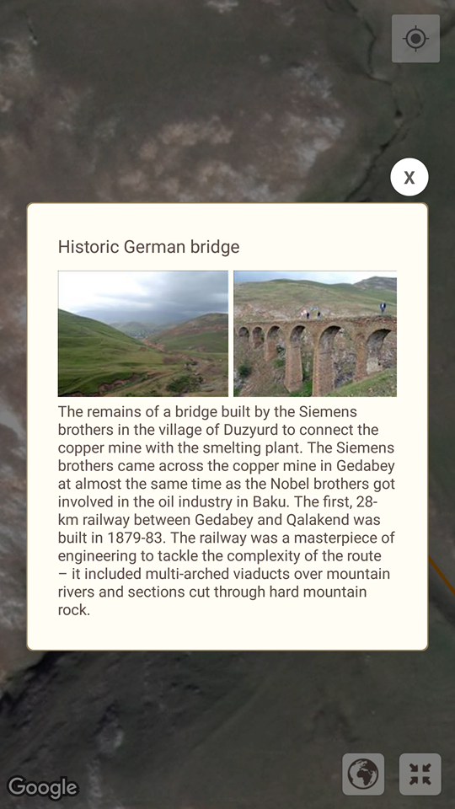
Mobile App TravelGIS
The bridge built by Siemens Brothers

Slide 21
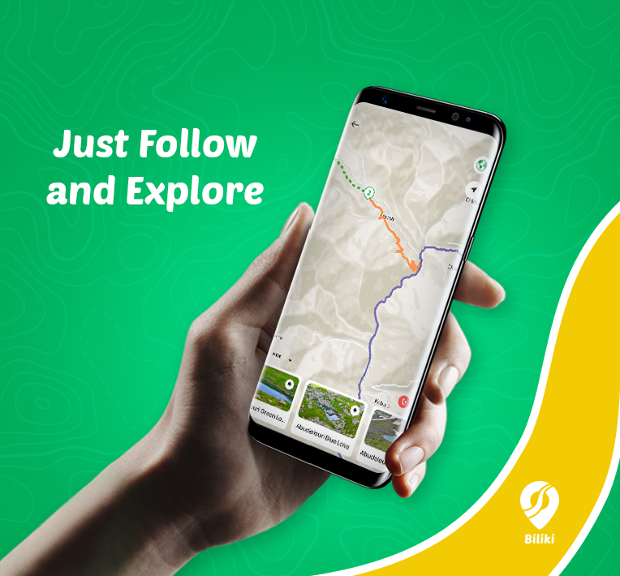
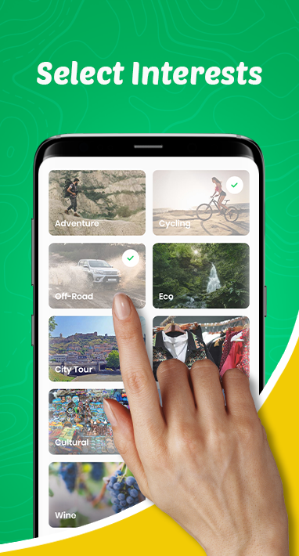
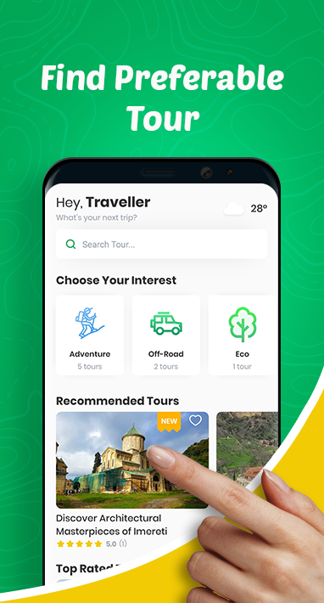
Mobile App Biliki
To make travel planning easier and to help travelers get the best out of their journeys
By providing tourist routes, information about tourist objects and useful hints
We created irreplaceable mobile tool for travelers in Georgia
Sponsored by The University of Georgia

Slide 22
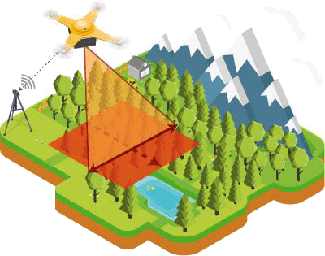
What’s Next?
Create GIS laboratory with sufficient equipment
Use latest licensed GIS Software
Purchase a GIS drone for 3D scanning and creation of 3D GIS Maps
Increased opportunities for our Students
Managing
Planning
Analysis

Slide 23
Thank You for Attention!
Sergo Tsiramua
+995 591 992987
s.tsiramua@ug.edu.ge
www.ug.edu.ge
GeorgeTsiramua
+995 599 883398
gtsiramua@bilikiapp.com
www.bilikiapp.com
Tbilisi 2019

